Slide 1
Aggregate Functions
Aggregate functions in SQL perform calculations on a set of values and return a single value. They are essential for summarizing data in databases, making it easier to analyze trends and draw insights.

Slide 2
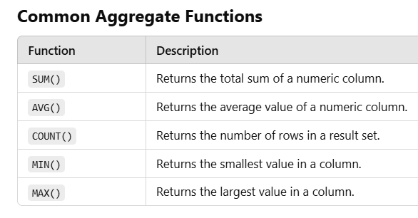

Slide 3
Count()
including NULL
Count( * ) → Return total number of records
Count( salary ) → Return the no. of non- null values over the column salary
Count( distinct salary ) → Return the no. of distinct non- null values over the column salary

Slide 4
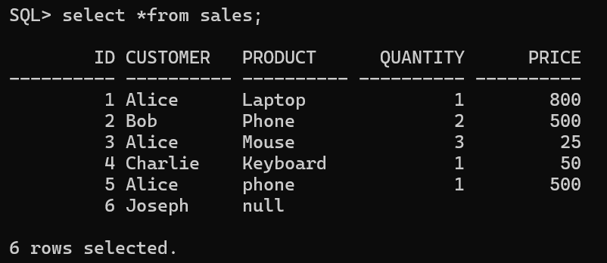
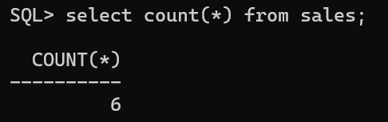

Slide 5
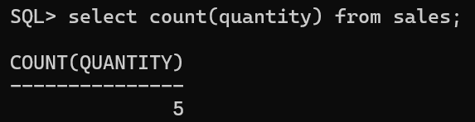

Slide 6
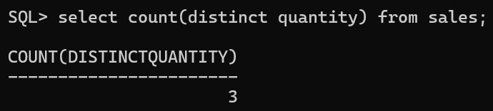

Slide 7
sum()
sum( salary) → sum all non – null values of column salary
sum( distinct salary) → sum all distinct non – null values of column salary

Slide 8
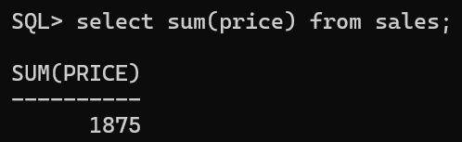

Slide 9
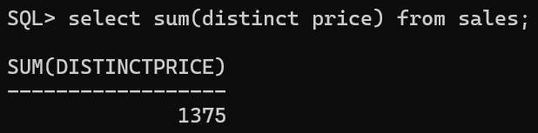

Slide 10
avg()
avg( salary) → avg all non – null values of column salary
avg( distinct salary) → avg all distinct non – null values of column salary

Slide 11
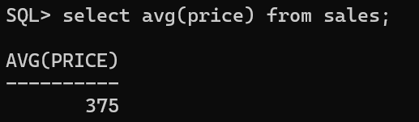

Slide 12
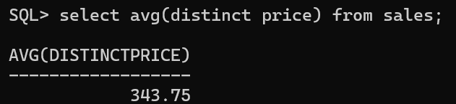

Slide 13
min()
min( salary) → minimum value in the salary column except null values.

Slide 14
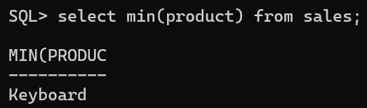
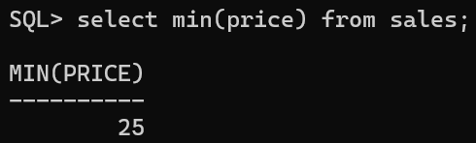

Slide 15
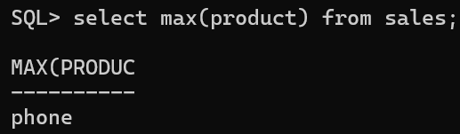
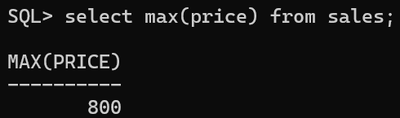

Slide 16
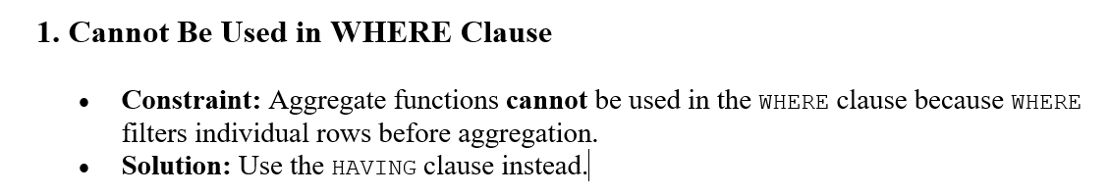

Slide 17
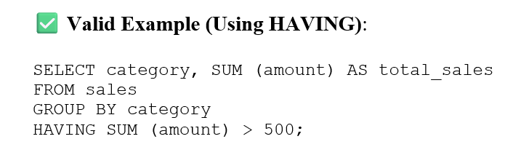

Slide 18
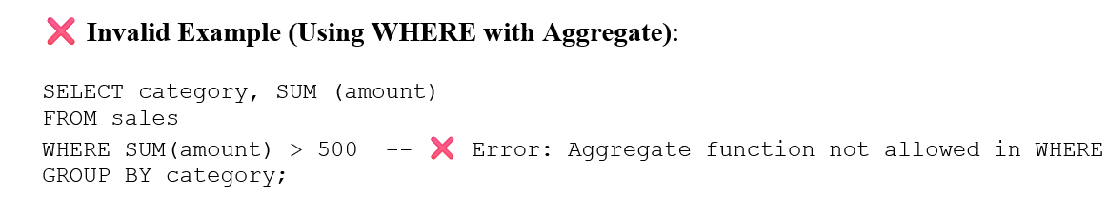

Slide 19
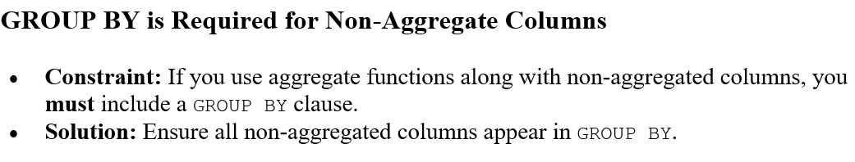

Slide 20
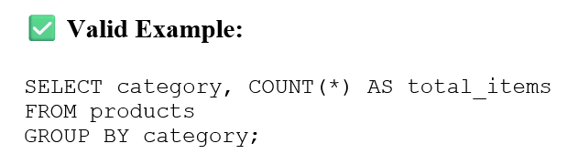
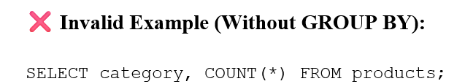

Slide 21
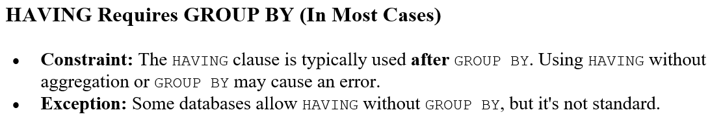
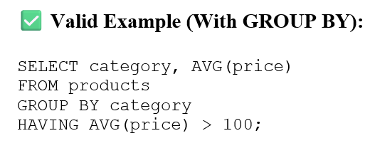

Slide 22
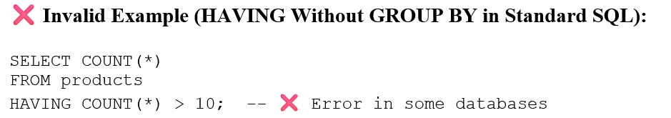

Slide 23
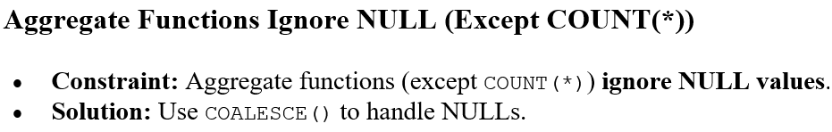

Slide 24
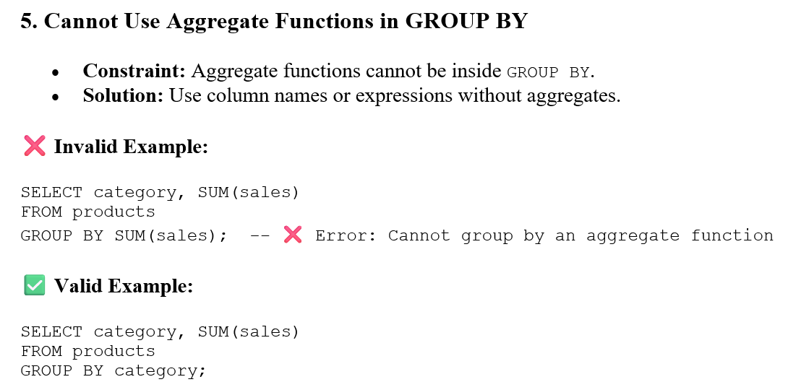

Slide 25
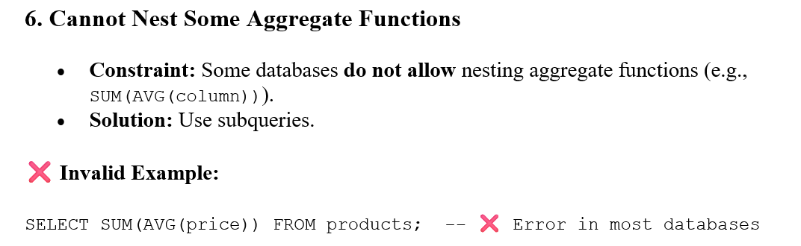

Slide 26
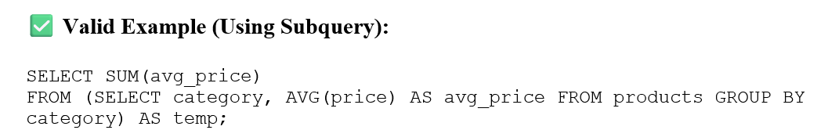

Slide 27
Constraint | Explanation | Solution
Cannot use aggregates in WHERE | Aggregates work on groups, but WHERE filters individual rows. | Use HAVING instead.
Must use GROUP BY when mixing aggregates & non-aggregates | Ensures proper grouping before aggregation. | Add GROUP BY with non-aggregated columns.
HAVING requires GROUP BY (in most cases) | HAVING filters groups after aggregation. | Use GROUP BY before HAVING.
Cannot use aggregate functions in GROUP BY | GROUP BY defines groups, not computed values. | Use column names, not aggregates.
Cannot nest aggregates in most cases | SQL does not support direct nesting of aggregate functions. | Use subqueries for nested aggregation.

